Slide 1


Denis Keil
November 2022

Slide 2

Outline
Executive Summary
Introduction
Methodology
Results
Conclusion
Appendix

Slide 3
Executive Summary
Summary of methodologies
Data collection via different proceedings (API-Interface, Web Scraping, API Scraping)
Data wrangling
Exploratory data analyzing with SQL and visualization
Interactive visual analytics with Folium and Dashboard
Predictive Analysis for different classification model by using machine learning
Summary of all results
Exploratory data analysis for the results of the different classification models
Interactive analytics demo in screenshoots
Predictive analysis results

Slide 4
Introduction
Project background and context
Spaxe X advertises its Falcon 9 rocket launches at the low cost of $62 million, while other vendors charge launch costs in excess of $165 million. The immense difference in cost is due to the reuse of the first stage. Therefore, there is a great interest for alternative companies to Space X to be able to predict whether or not after a rocket launch the first stage can land again and be reused. Thus, the declared goal of this project is to create a pipeline for machine learning with different classifiers in order to be able to predict as best as possible whether there will be a successful landing of the first stage.
Problems you want to find answers
Are there certain factors influencing the success rate for a successful first stage landing. Is there a correlation between various factors for a successful land maneuver?

Slide 5

Section 1

Slide 6
Methodology
Executive Summary
Data collection methodology:
Data were collected bei using SpaceX-API und web scraping from Wikipedia page
Perform data wrangling
Data were cleaned from irrelevant informations and creating one-hot-encoding datafields for machine learning
Perform exploratory data analysis (EDA) using visualization and SQL
Data were visualized bei different plotkinds for searching for pattern
Perform interactive visual analytics using Folium and Plotly Dash
Perform predictive analysis using classification models
How to build, tune, evaluate classification models

Slide 7
Data Collection
Data were collected by different proceedings
Requesting the SpaceX-API
Decoding the response content, coming in json-format, and turn into a Pandas dataframe
Cleaning dataframe from uninteresting columns and multiple rows
Filter according to desired parameters
Checking the dataset for missing data and filling missing data up where required
Web-Scraping an Wikipedia page for Falcon 9 launch records by using BeautifulSoup
Transforming the received html-table into a Pandas dataframe

Slide 8
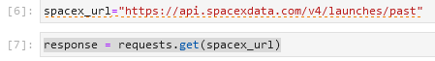
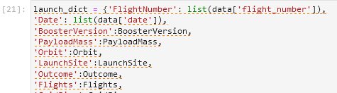
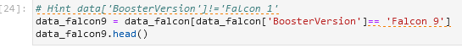
Data Collection – SpaceX API
1.
The following workflow was used
Getting response from SpaceX-API
Converting response to json-file and transferring into a dataframe
Clean up the data using prepared functions
Creating a final dataset with the columns of interest
Filtering dataset for selected BoosterVersion
GitHub-link to notebook: https://github.com/dekeil/Coursera_Capstone-Project/blob/main/jupyter-labs-spacex-data-collection-api_01.ipynb
2.
3.
4.
5.

Slide 9
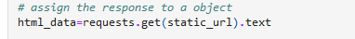
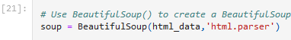
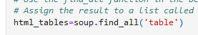
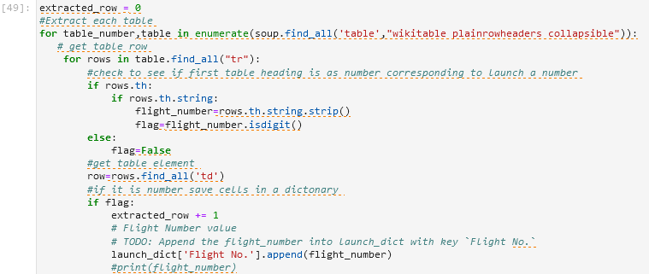
Data Collection - Scraping
The following workflow was used
Requesting Falcon9 Launchdata from Wiki-page
Creating Beautiful-soup object from HTML response
Extract all column/variable names from the HTML table header
Create a data frame by parsing the launch HTML tables
Exporting data to CSV-file
GitHub-link to notebook: https://github.com/dekeil/Coursera_Capstone-Project/blob/main/jupyter-labs-webscraping_02.ipynb
1.
2.
3.
4.
5.

Slide 10
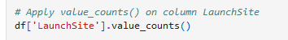
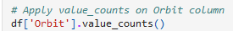
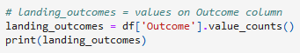
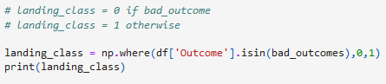

Data Wrangling
Exploratory Data Analysis and Determine Training Labels
Calculate the number of launches on each site
Calculate the number and occurrence of each orbit
Calculate the number and occurence of mission outcome per orbit type
Create a landing outcome label from Outcome column
Exporting data to CSV-file
GitHUB URL: labs-jupyter-spacex-Data%20wrangling.ipynb

Slide 11
EDA with Data Visualization
Different chart types and dependencies were plotted
Payload-Mass vs. Flight Number / Launchsite vs. Flight Number / Launchsite vs. Payload-Mass
orbit vs. success rate / Flight number vs. orbit / Payload Mass vs. orbit
Launch success yearly trend
The aim is to find patterns and dependencies in the plots, which can then be used to train the machine learning engine. The different chart types have different advantages for this.
scatterplots are useful to show relationships between variables
barcharts are suitable for comparing the ratio of a variable in discrete classes with one another, if necessary grouping them as well
lineplots show the progression of variables over time
GitHUB URL: jupyter-labs-eda-dataviz.ipynb

Slide 12
EDA with SQL
Display the names of the unique launch sites in the space mission
Display 5 records where launch sites begin with the string 'CCA'
Display the total payload mass carried by boosters launched by NASA (CRS)
Display average payload mass carried by booster version F9 v1.1
List the date when the first succesful landing outcome in ground pad was acheived
List the names of the boosters which have success in drone ship and have payload mass greater than 4000 but less than 6000
List the total number of successful and failure mission outcomes
List the names of the booster_versions which have carried the maximum payload mass. Use a subquery
List the records which will display the month names, failure landing_outcomes in drone ship ,booster versions, launch_site for the months in year 2015
Rank the count of successful landing_outcomes between the date 04-06-2010 and 20-03-2017 in descending order
GitHUB URL: jupyter-labs-eda-sql-coursera_sqllite_01.ipynb

Slide 13
Build an Interactive Map with Folium
objects added to the interactive map
all launch sites are marked on a map
NASA Johnson Space Center marked as a point using latitude and longitude coordinates and set as the center of the map, additionally identified with a text label
all X-space launch sites marked as a point, provided with a text label and plotted using the latitude and longitude coordinates. Thus marking the geographic location and distance to the equator
Drawing and color coding of the launch outcome for each start per launch site
adding a colored marker to the exact starting point for each launch site, green for successful launches, red for failed, this allows a quick overview of the success rate per launch site
Calculate the distances between a launch site to its proximities
Insertion of connecting lines from a selected launch site (CCAFS SLC-40) to the coast and nearby infrastructure such as the nearest railway line, highway or city. Determine an entry of the respective distances
GitHUB URL: lab_jupyter_launch_site_location.ipynb

Slide 14
Build a Dashboard with Plotly Dash
Dropdown list of all launch sites
Adding a dropdown list to select the possible launch sites
Creation of a pie chart with successful and failed launches (all sites combined / specific site)
Added a pie chart to show for all sites aggregated or a selected site - depending on selection - the total number of successful launches vs. failed launches for the sites
Include range slider for payload
Add a Range Slider to Select Payload
Scatterplot showing payload mass vs. success rate, selectable for the different booster versions
add a scatterplot to show the dependency between payload and launch success/success rate
GitHUB URL: spacex_dash_app.py

Slide 15
Predictive Analysis (Classification)
A total of 4 classification models were created and their results compared with each other (logistic regression, SVM, decision tree, k nearest neighbors) - the workflow is, however, basically similar for all of them
Importing data to dataframe and creating a NumPy array from column “class”
determine the model with the best predictive accuracy
contrast and compare the models by evaluating the jaccard_score and F1_score
Standardize data with StandardScaler and transform it
split dataset into train and test set with train_test_split
Examining the confusion matrix
Creating a object for the classification model
Calculating the accuracy on the test set by using „score“ method
Create a GridSearchCV object to find the best parameter and set parameters for the specific classification model
Applying GridSearchCV on the model
GitHUB URL: SpaceX_Machine%20Learning%20Prediction_Part_5.ipynb

Slide 16

Section 2

Slide 17
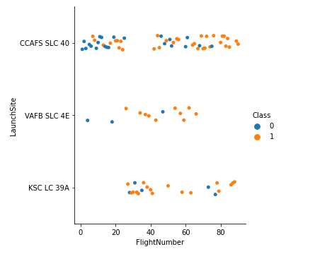
Flight Number vs. Launch Site
the first launch attempts were made from the CCAFS SLC 40 launch site
the probability of success increased as the starting attempts progressed
Starting places with the best success rate are VAFB SLC 4E and KSC LC 39A

Slide 18
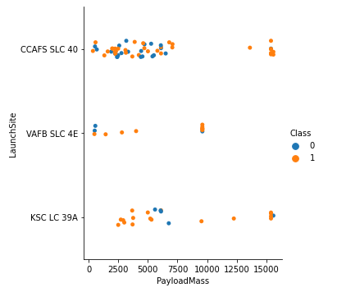
Payload vs. Launch Site
all launch sites show a high success rate for a high payload
Launch site VAFB SLC 4E seems unsuitable for launches with high payloads

Slide 19
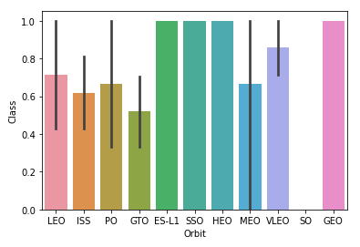
Success Rate vs. Orbit Type
Orbits with success rate greater 80% are ES-L1, SSO, HEO, VLEO and GEO
Orbits with success rates between 50 – 80% are LEO, ISS, PO, GTO and MEO
Orbit without successful launches is SO

Slide 20
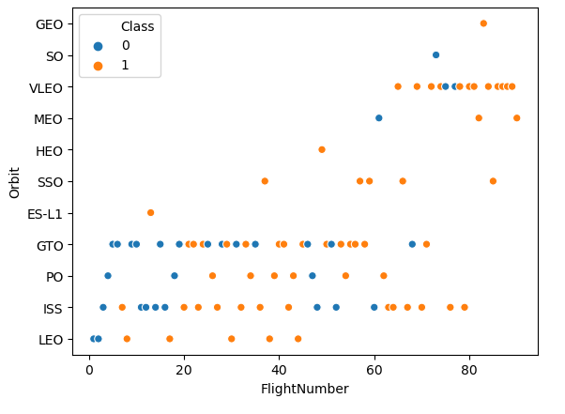
Flight Number vs. Orbit Type
most and also first launches were in low orbit up to the GTO, here the chances of success increased with the number of launches
most of the tests in orbit VLEO were successful

Slide 21
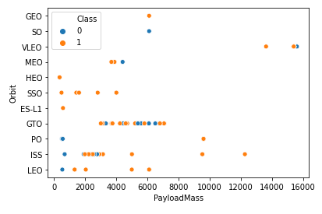
Payload vs. Orbit Type
apparently there is no general relationship between payload and orbit
low orbits show a low success rate with a low payload, but this could also have been the first launch attempts and caused by this
The orbits GTO and ISS had the most launches, while ISS also had the widest spread of payloads

Slide 22
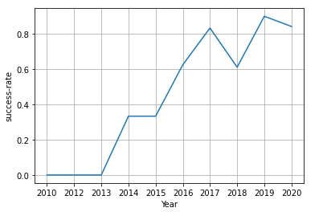
Launch Success Yearly Trend
in the years 2010 - 2013 there were no successful launch attempts
in the following years there was a sharp increase in the probability of success
the year with the highest probability of success (> 90%) was 2019

Slide 23
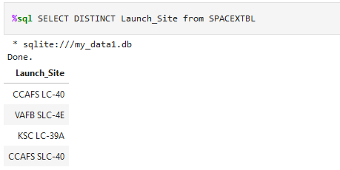
All Launch Site Names
Query with the keyword "DISTINCT" returns all launch sites once

Slide 24
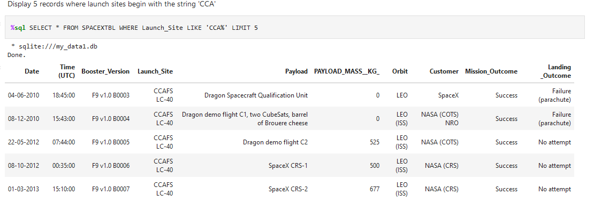
Launch Site Names Begin with 'CCA'
The query result shows a selection of 5 entries in the "Launch_site" column which start with "CCA"

Slide 25
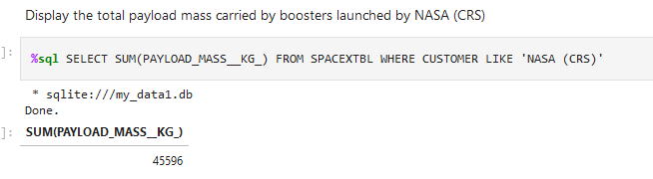
Total Payload Mass
the result returns the total payload of all launches on behalf of NASA

Slide 26
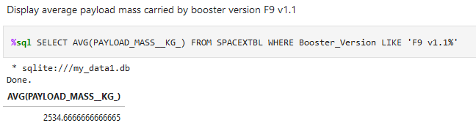
Average Payload Mass by F9 v1.1
the result gives the average payload of the launches with the booster version "F9 v1.1"

Slide 27
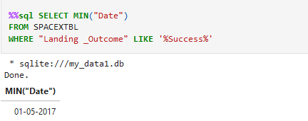
First Successful Ground Landing Date
Query returned the first successful landing on 01/05/2017

Slide 28
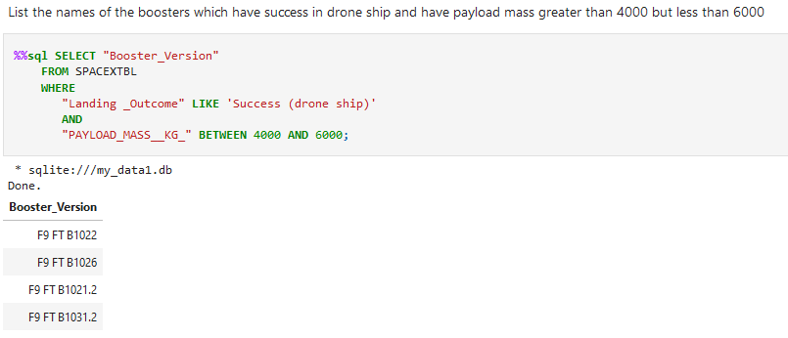
Successful Drone Ship Landing with Payload between 4000 and 6000
Result lists the names of boosters which have successfully landed on drone ship and had payload mass greater than 4000 but less than 6000

Slide 29
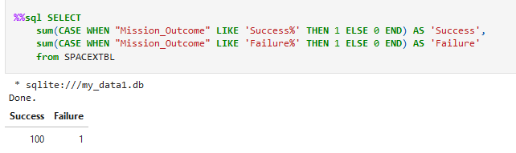
Total Number of Successful and Failure Mission Outcomes
Returning the query returns the sum of the successful and failed mission outcomes

Slide 30
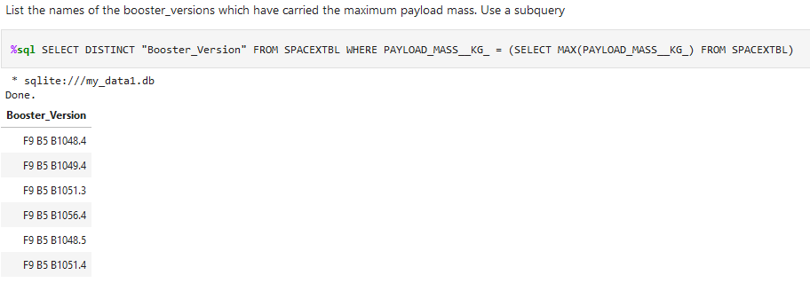
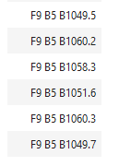
Boosters Carried Maximum Payload
Query returns the names of the booster versions that carried the maximum payload, 12 booster versions in total

Slide 31
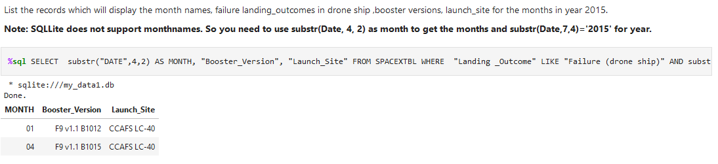
2015 Launch Records
the combined query returns the names of the booster versions, the launch site and the landing outcome for all launches in 2015 that had a failed landing outcome in drone ships

Slide 32
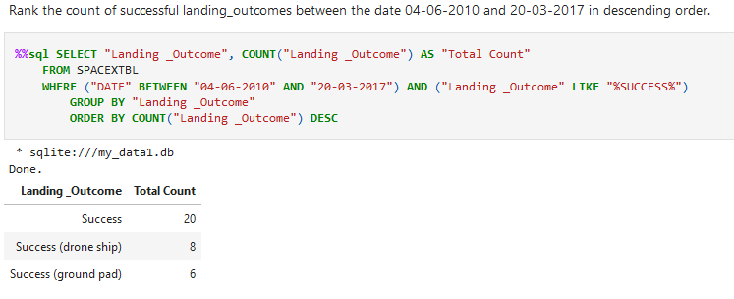
Rank Landing Outcomes Between 2010-06-04 and 2017-03-20
the combined query returns the landing outcome and the number of landing outcomes for all launches between 2010-06-04 to 2017-03-20. Here, the summation is carried out over the different landing outcomes and an output in descending order

Slide 33

Section 3

Slide 34

Location of all launch sites
All the launch sites for the Space X missions are marked on the map.The proximity to the coast in the west and east can be clearly seen, as well as the relative proximity to the equator.

Slide 35
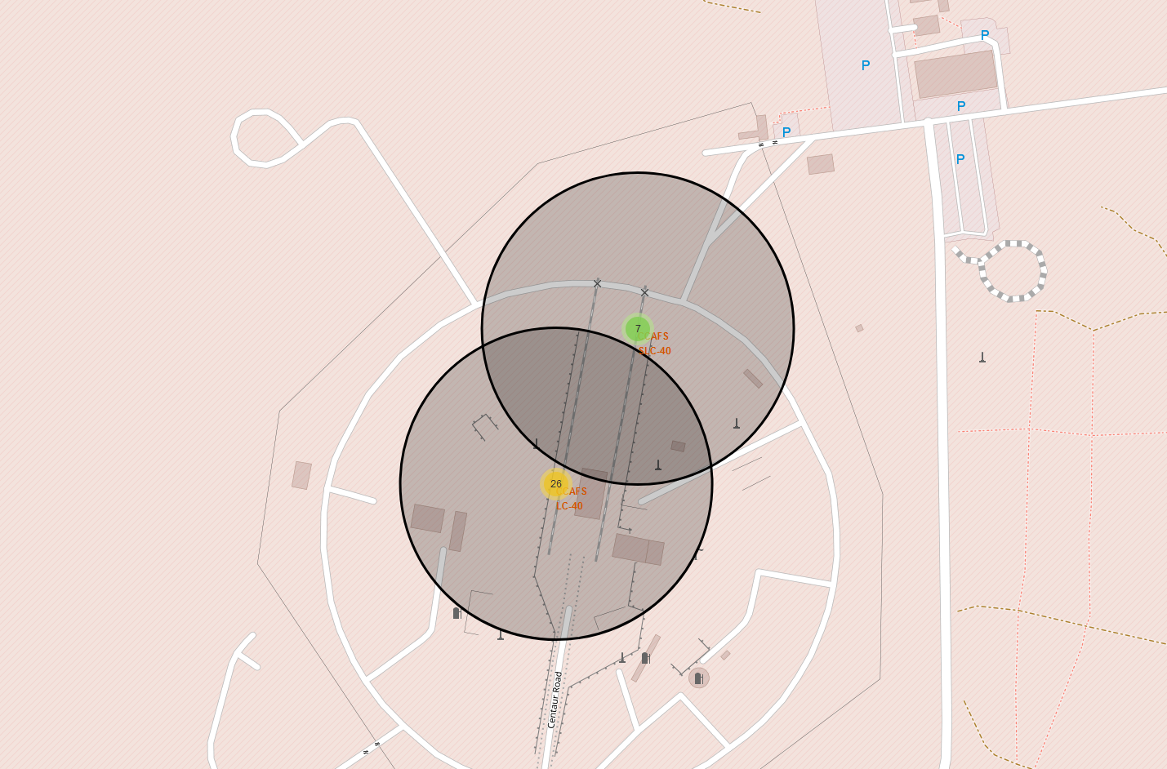
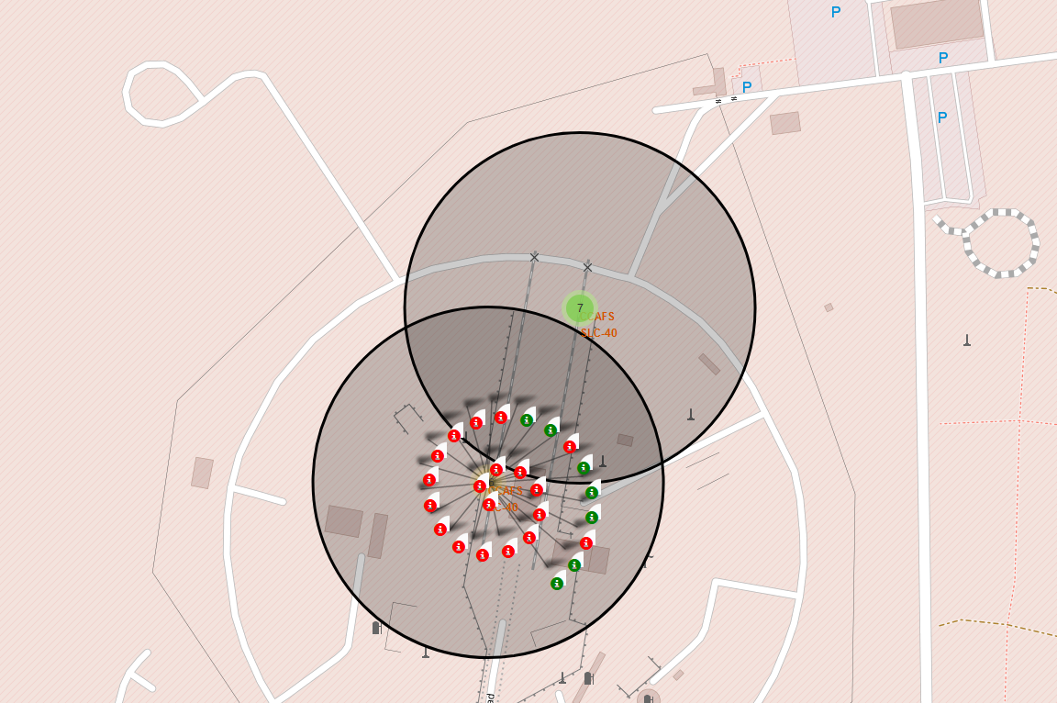
Launch results for site CCAFS
Maps give an overview of the total number of starts at the respective starting place
Map section provides a detailed insight into the launch attempts carried out. On the one hand the exact starting position and then the mission result - red marker means failure, green marker means success

Slide 36
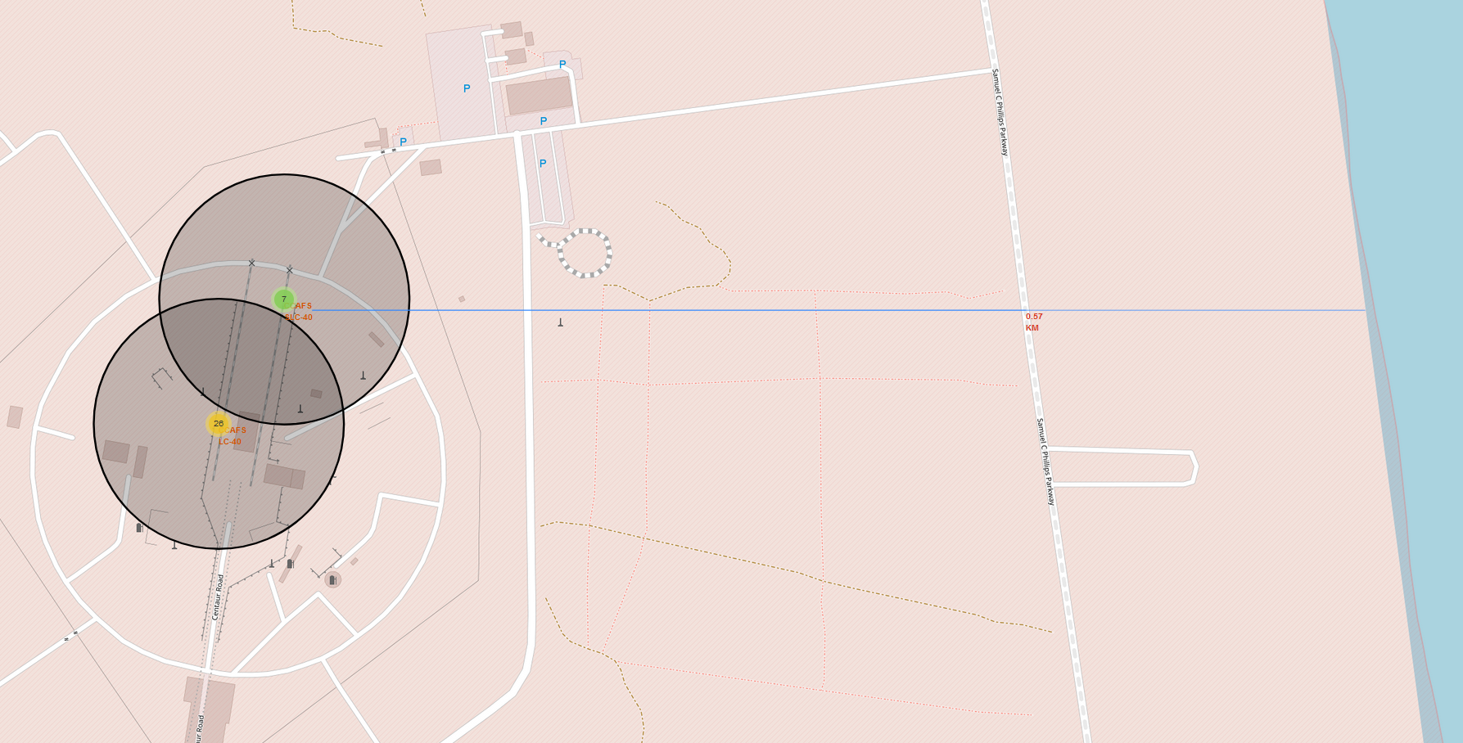
Infrastructure around the launch site
The section shows that the launch site is in close proximity to the coast (0.57 km).
Other infrastructure such as roads and railways are also in close proximity.
Distance to inhabited areas and cities, on the other hand, is greater for safety reasons.
Folie offen

Slide 37

Section 4

Slide 38
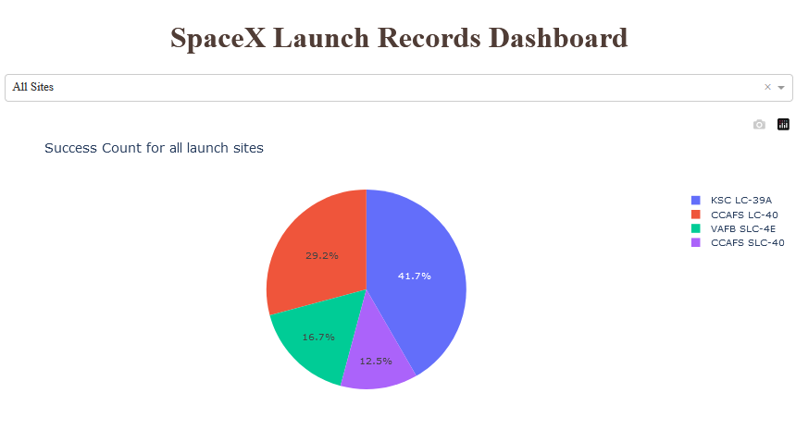
Start success overview for all start sites
The graphic shows that most successful launch attempts took place at the launch site "KSC LC-39A". In total, more than 2/3 of the total successful missions ran at the two launch sites "KSC LC-39A" and "CCAFS LC-40".

Slide 39
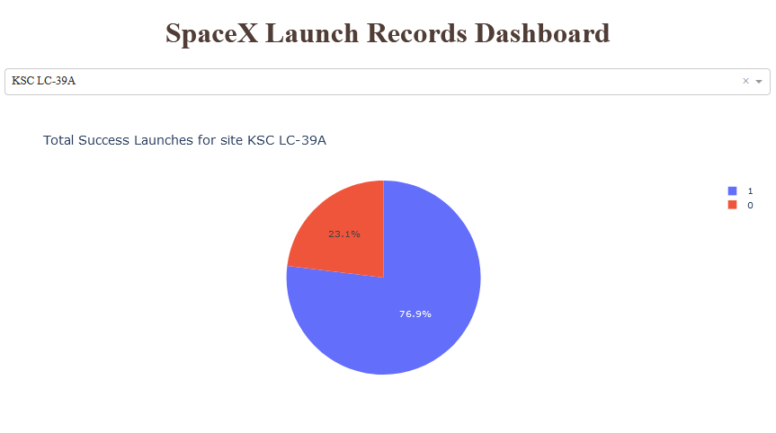
Launch successes at KSC LC-39A
Of the missions performed at the "KSC LC-39A" launch site, 76.9% were successful and 23.1% failed.

Slide 40
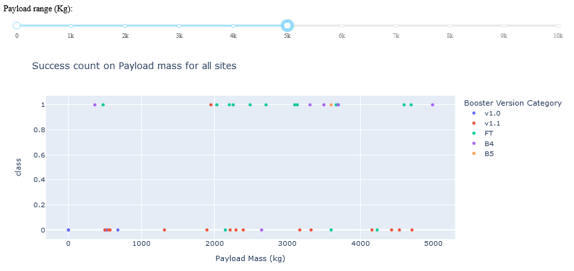
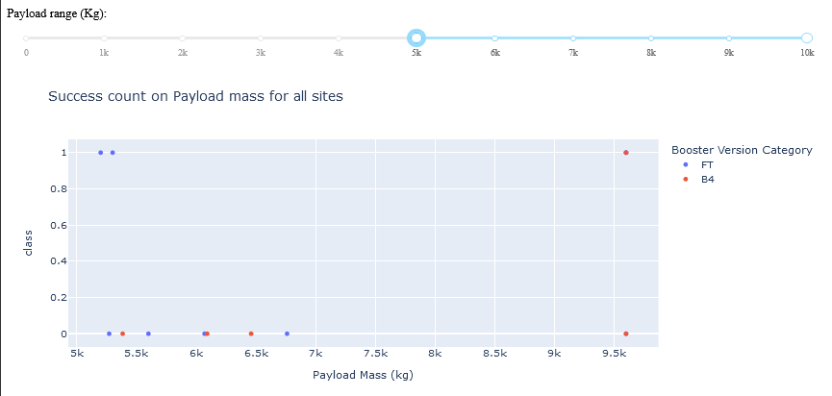
Launch successes at different payload masses
Lower range of payload mass
Higher range of payload mass
The dashboard shows a variety of information:
with the booster version v 1.0 and v1.1 there were almost only failed attempts, the payload was also still quite low
Booster version "FT" had the highest chance of success, especially in the payload between 2000 - 5500kg
- with a payload of more than 5500kg, the probability of success decreased significantly

Slide 41

Section 5

Slide 42
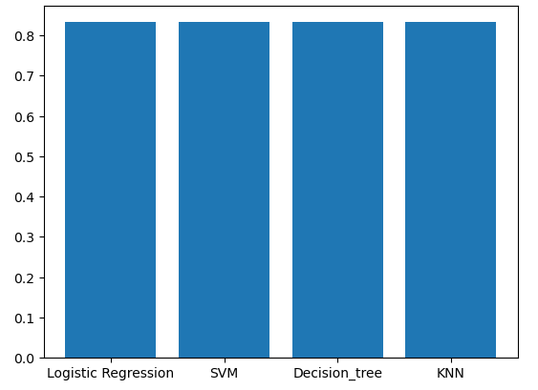
Classification Accuracy
the accuracy for all models are the same by using the test dataset.
When using the training data set, however, different accuracies were found. here the decicion tree performed best.

Slide 43
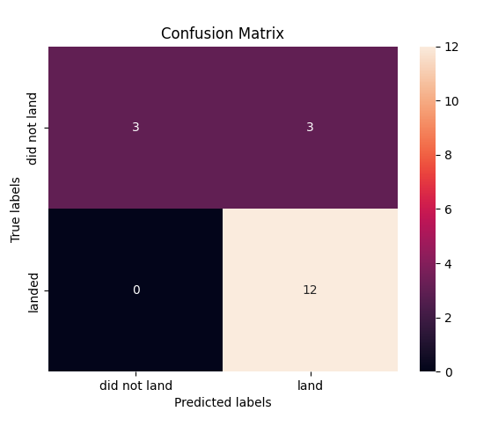
Confusion Matrix
The confusion matrix of the decicion tree is shown. The classifier had to make a total of 18 predictions.
12 successful landings were correctly predicted, or 3 cases in which the landing failed.
There were also 3 erroneous predictions. All three were real failed landing attempts which were predicted to be successful. There was no case where a failed landing was predicted as a successful one.

Slide 44
Conclusions
the years 2010 to 2013 were less successful (possibly also used to adapt and gather experience) and from 2013 to 2020 the success rate rose continuously
with an increasing number of launch attempts at a launch site, the chance of success also increased
A payload that is too high or very low also has a negative effect on the probability of success
Launch site with the highest success rate was KSC LC-39A
decision tree classifier is the best classifier for this task.

Slide 45
Appendix
Folium does not render map views in the github, so the maps are only visible in the presentation

Slide 46


